Slide 1

Credit Default
Group 5
Diwei Zhu Gabriela Caballero Kunyang Que Ullas Srivastava Yangxing Liu

Slide 2



Agenda
Models comparison
Business Objective
Chosen model
5
1
6
Data overview
2
4
Exploratory data Analysis
8
3
Data Cleaning
Business Implications

Slide 3
Business Objective
Problem:
“
How do our clients meet the loan requirements?
Nearly 1/3 of personal loan seekers leave the bank unhappy, and as many as 21% fail to pay back their loans on time
Solution:
Find what it takes to get your loan accepted
Using our predictive modelling and the first hand banking data related to the consumer loans, revolving loan and cash loans
Deloitte Insights 2017

Slide 4
Data Overview
292,132 rows
Cleaning Technic
Removing outlier
Filling missing data
Creating bins for trees
One hot encoding
Dropping duplicate columns
304 columns
4 files

Slide 5
Data Review
previous_application
all previous loans history
application_train
SK_ID_CURR (unique loan id) TARGET (binary, prediction variable) info about loan and loan applicant history record count approved rate amount of loans to pay usage of different type of loans
SK_ID_CURR
Credit_card_balance
-monthly balance of credit card -behavioral data
SK_ID_CURR
Notes:
106] "CREDIT_CARD_RECORD_COUNT"
user's record count in credit card dataset
[107] "AMT_BALANCE"
The money user owe the bank in the latest record
[108] "AMT_CREDIT_LIMIT_ACTUAL"
The maximum credit the bank authorized to the user
[109] "NAME_CONTRACT_STATUS"
the status of overall loan contract of the user
[113] "PREV_RECORD_COUNT"
user's total record count in previous application dataset( removed cancelled application)
[114] "CASH_LOANS_COUNT"
user's application count for cash loan in previous application dataset
[115] "CASH_LOANS_APPROVE_RATE"
Of all the application to cash loans, the percentage(0-1) the bank approved(included approved but used situation)
[116] "COMSUMER_LOANS_COUNT"
[117] "CONSUMER_LOANS_APPROVE_RATE"
[118] "REVOLVING_LOANS_COUNT"
[119] "REVOLVING_LOANS_APPROVE_RATE"
[120] "CNT_PAYMENT_AVG"
the average month of installment of all loans above for a user

Slide 6
Models Run without joined external data
 | Logistic Unbalanced | Logistic Balanced | Boosting Tree | Boosting Tree with cross validation
Accuracy | 91% | 78% | 92% | 71%
Sensitivity | 94% | 79% | 99% | 72%
Specificity | 19% | 50% | 1.5% | 64%

Slide 7
Models Run with joined external data
 | Logistic Unbalanced | Logistic Balanced | Boosting Tree | Boosting Tree with cross validation | Gradient Boosting Tree
Accuracy | 92% | 65% | 92% | 71% | 83%
Sensitivity | 99% | 65% | 100% | 72% | 81%
Specificity | 0.2% | 59% | 0% | 64% | 85%

Slide 8
Data Sets
292329
Subsetting
29233
90% less
original set
training set
Boosting trees
Logistic Model
separate data sets

Slide 9
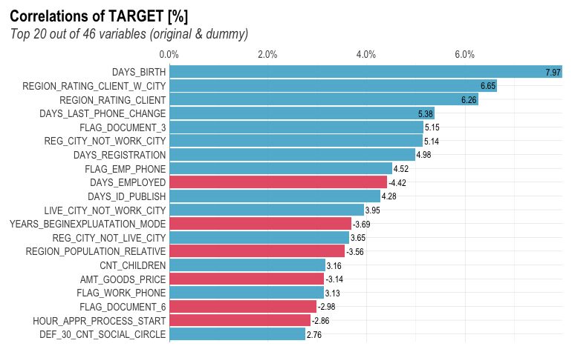
Exploratory Data Analysis
260000+
Correlation analysis of the TARGET variable
Highly unbalanced data
Our solution:
OVERSAMPLING
DAYS_BIRTH
+ correlation
20000+
DAYS_EMPLOYED
- correlation
Able
Unable

Slide 10
Models Used
Unbalanced Logistic Regression
Balanced Logistic Regression
Gradient Boosting Tree
Boosting
Tree
Boosting Tree with cross validation

Slide 11
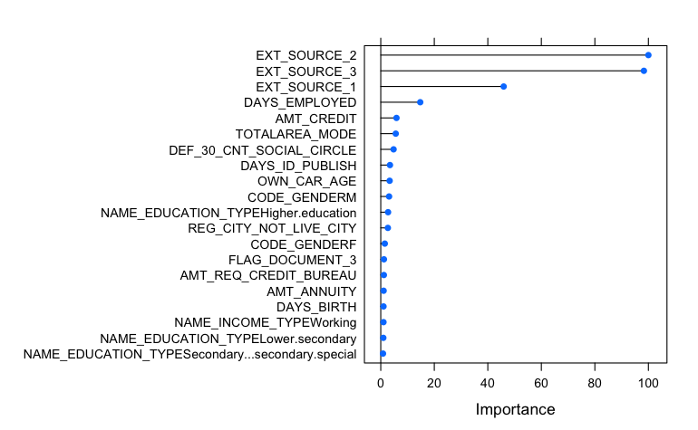
Features of importance of Boosting Tree without joined external data

Slide 12
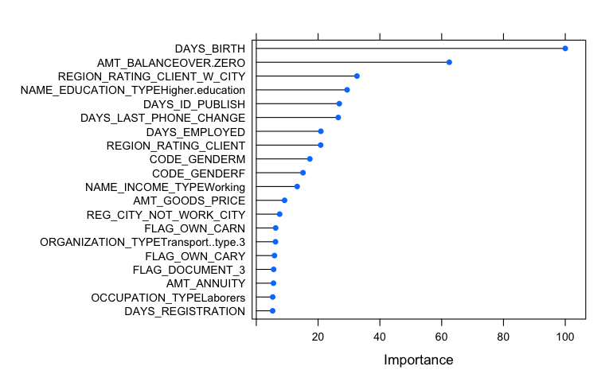
Features of importance of Boosting Tree with joined external data

Slide 13
Model Chosen: Gradient Boosting Tree
85%
83%
81%
Accuracy
Sensitivity
Specificity

Slide 14
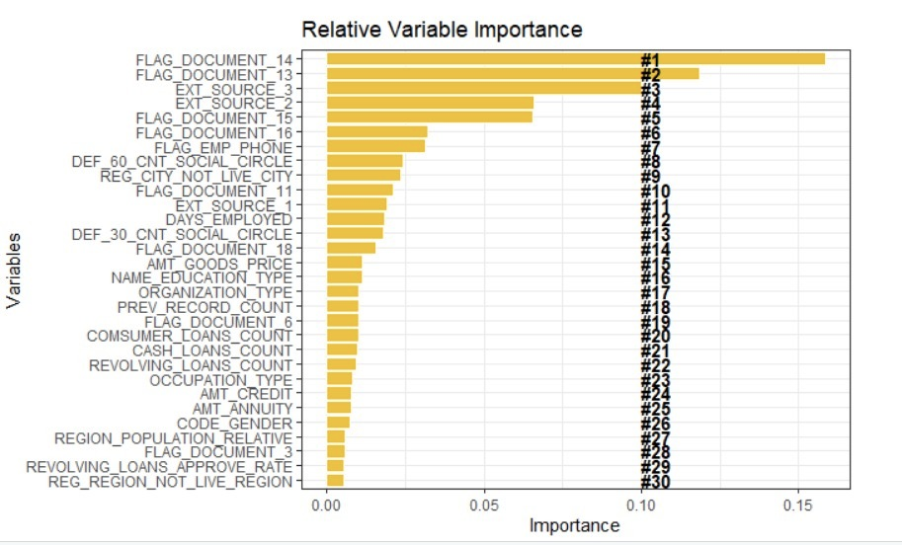
Features of importance of Gradient Boosting Tree

Slide 15
LoanProof
Get your Loan Approved

Slide 16
Three things to focus:
Things we can help you!
External sources
Documentations
background

Slide 17
Service : Document preparation
Predictive analysis shows the following documents are a priority:
Our assistance include:
Important forms curations
Forms identification
Top-level writers
Experienced consultants
Document_14
Document_13
Document_15
Document_18
Document_3
BirthDate
Social Circle
Ext_src

Slide 18
Service: Background Evaluation
Your background matters to get a loan
How we can help:
Finance expert
Property consultants
Career counsellors
Secure handling of sensitive data
Living Place
Employment
Credit Report
Property

Slide 19
Service: Credit Evaluation
Banks are highly depends on external source to estimate your pay back ability.
How we can help:
Good relationship with source institution
Techniques to nail credit evaluation
Portfolio boosting
EXT_source2
Approve rate
EXT_source1
EXT_source3

Slide 20
Our Success Relies on
Focus Parameters
Helping with the application information
Facilitating documents types
Partnering with external credit sources
Assuring robust background portfolio for loan repayment
Notes:
social surroundings defaulted on 60 (days past due)

Slide 21
Thank you!

